Slide 1
Unit 15: My family’s weekend
Lesson 3_Period 5

Slide 2
Table of contents
01
02
03
04
05
Warm up
Activity 1
Listen and repeat
Activity 2
Listen and circle
Activity 3
Let's chant
Fun time

Slide 3
Warm up
01

Slide 4

3
4
2
6
5
1
Next

Slide 5


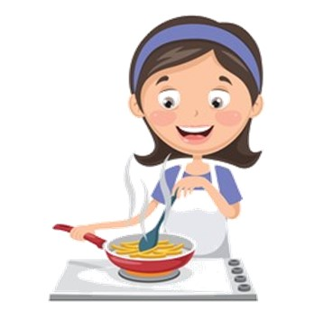
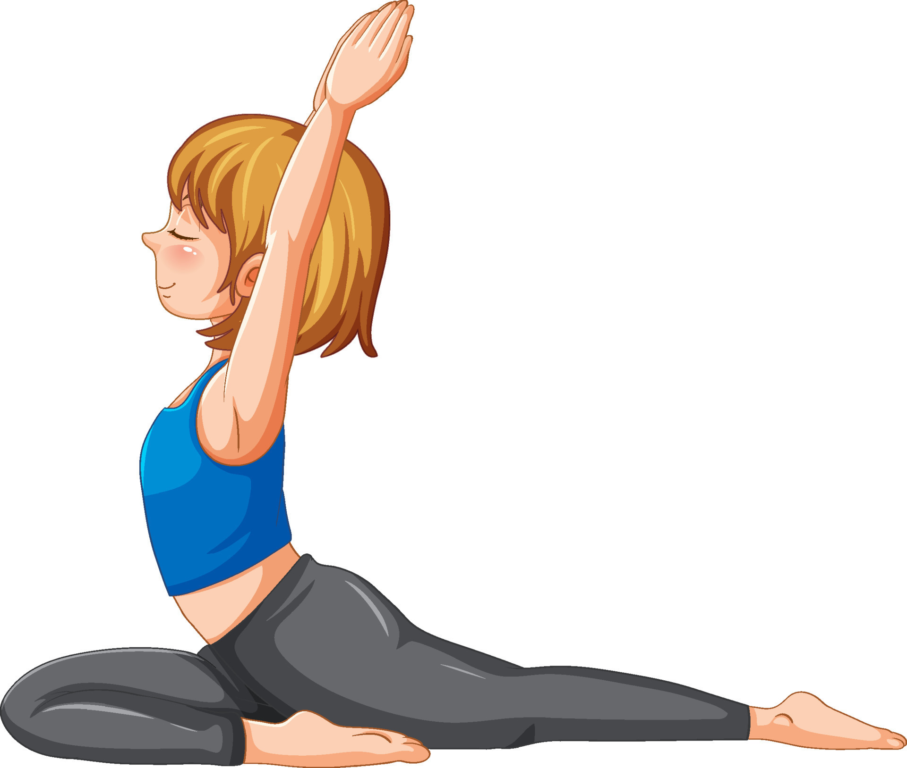
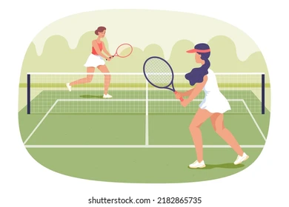
My mother cooks meal.
+ 5
A
B
C
Notes:
There are two chairs in my bedroom. They’re new.
Key: A

Slide 6

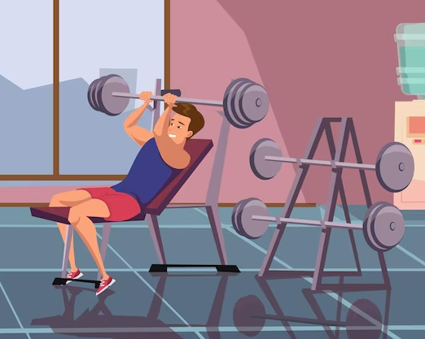
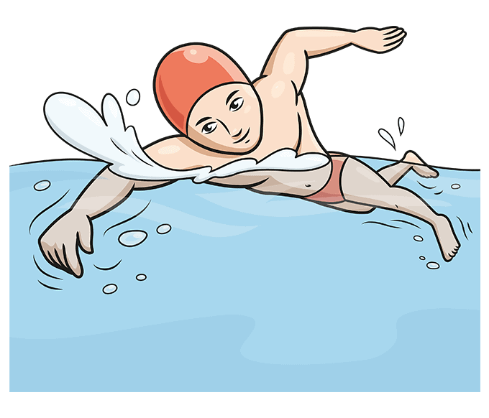
My father goes to the sports centre.
+ 4
A
B
C
Notes:
There is a window in the living room. It’s big.
Key: B

Slide 7
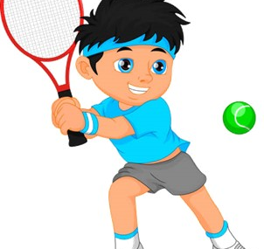

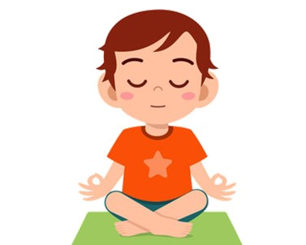
My brother watches films.
+ 2
A
B
C
Notes:
There is a bed in my bedroom. It’s old.
Key: B

Slide 8
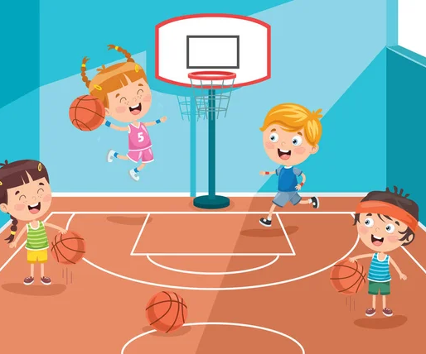
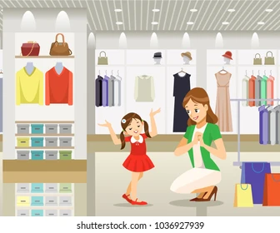

My sister goes to the swimming pool.
+ 3
A
B
C
Notes:
There are two chairs. They’re big.
Key: C

Slide 9
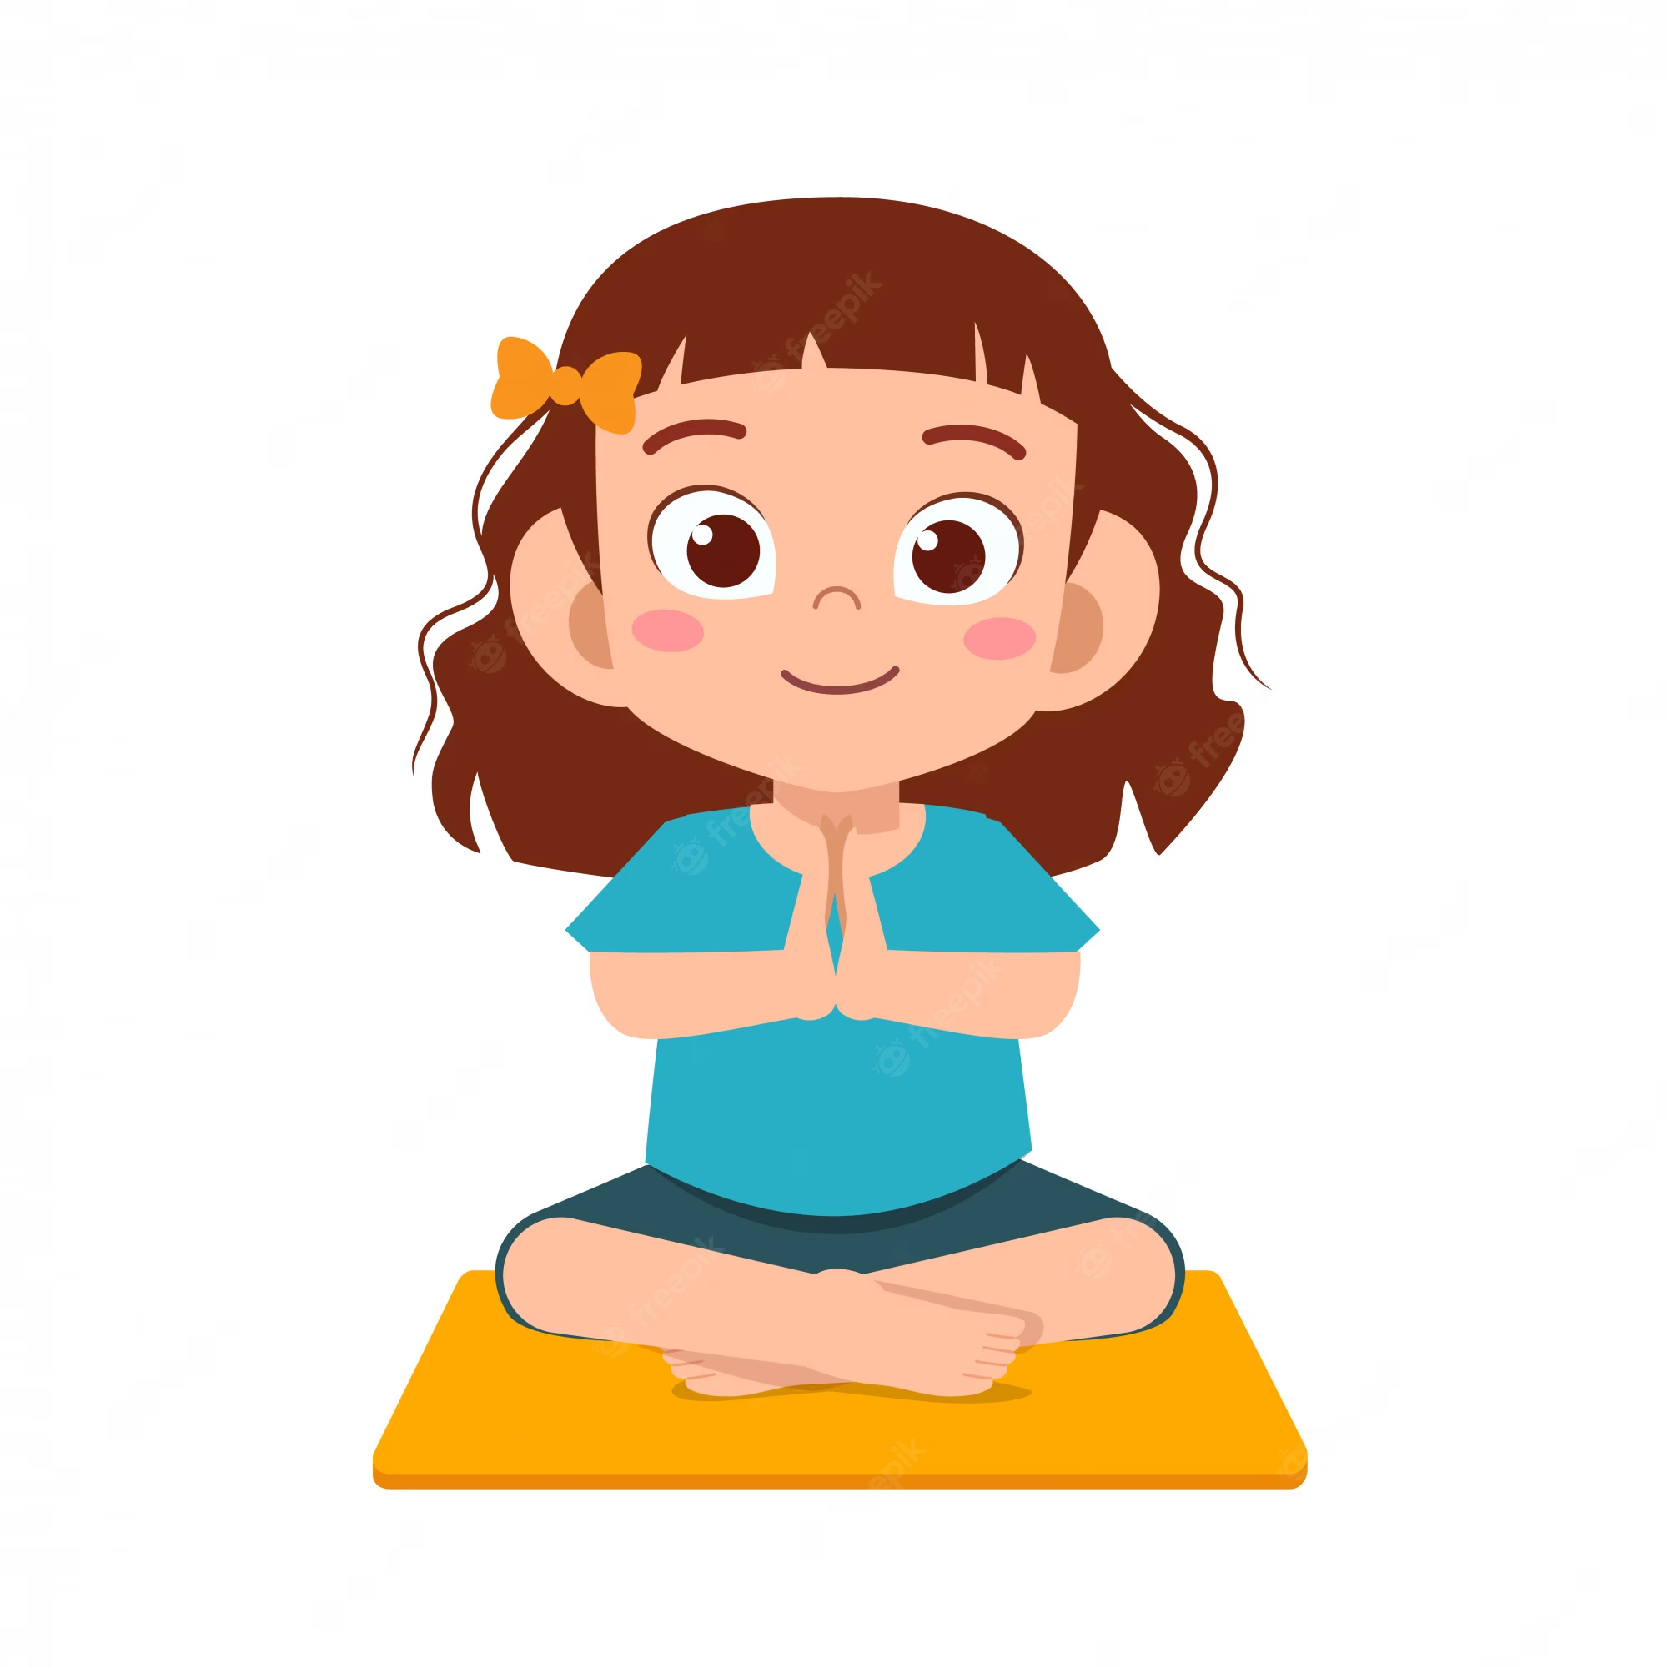
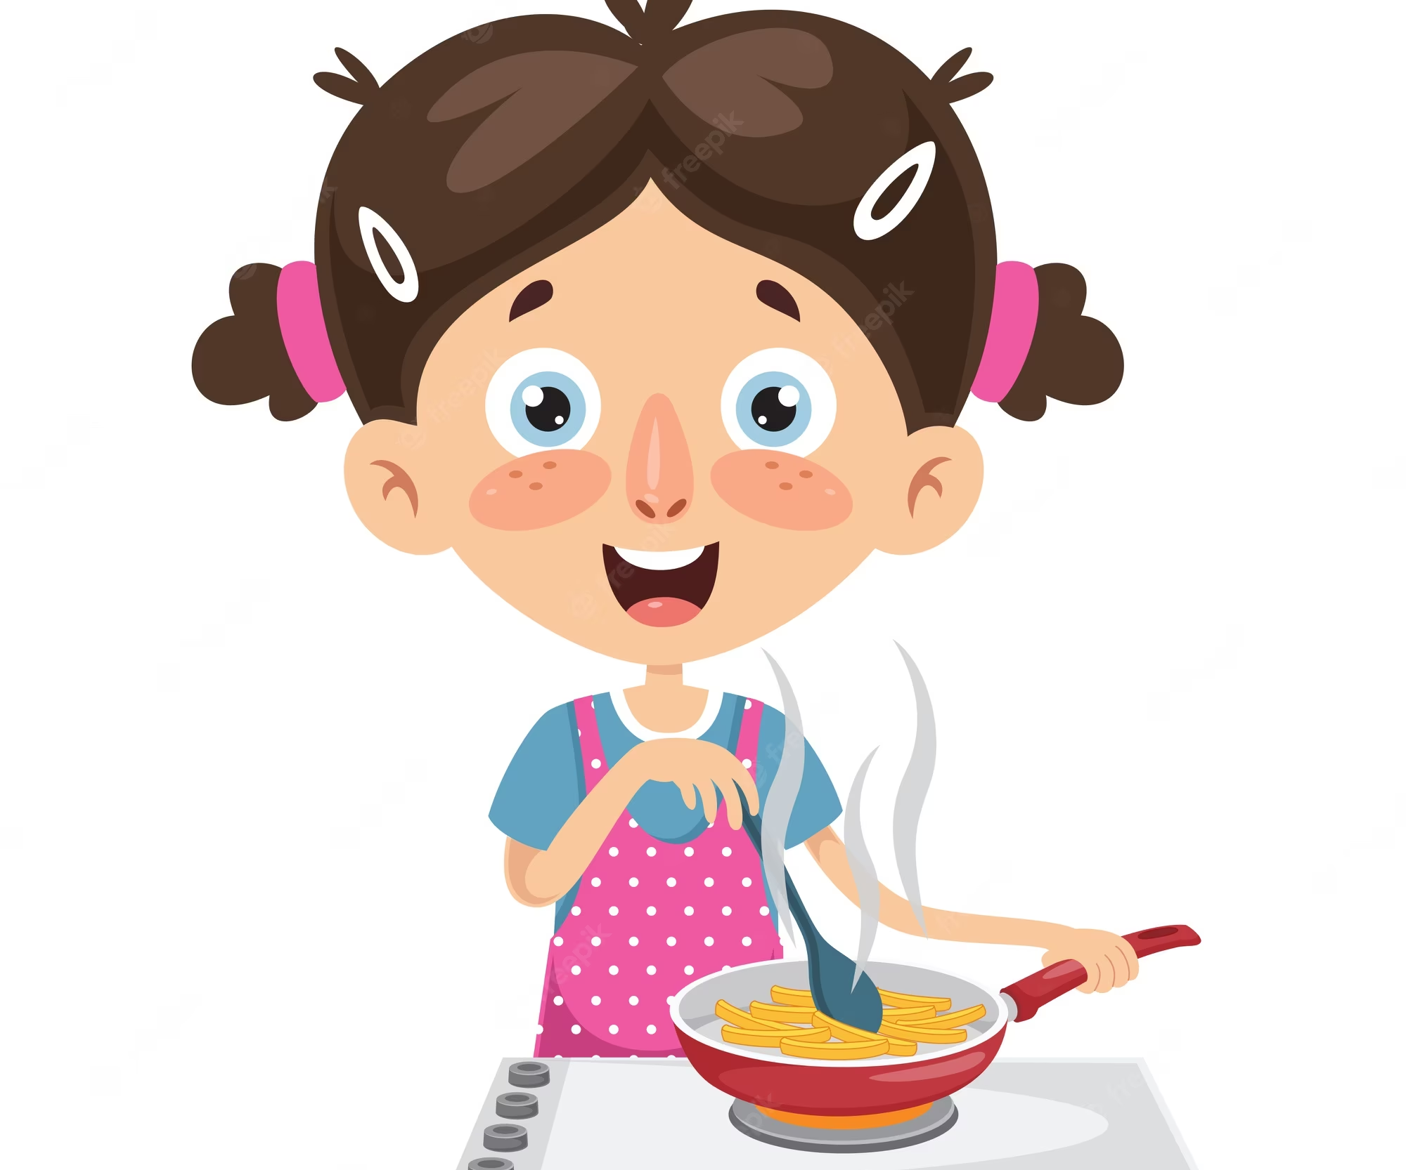
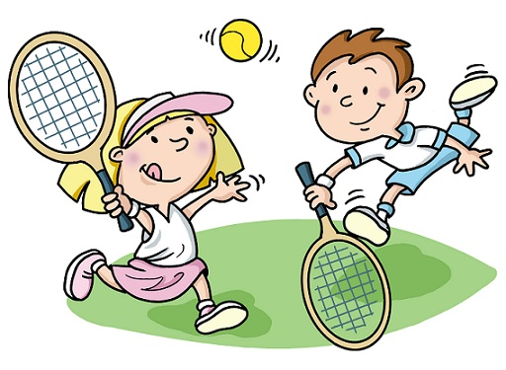
My sister does yoga.
+ 5
A
B
C
Notes:
There are two doors in the living room. They’re small.
Key: A

Slide 10

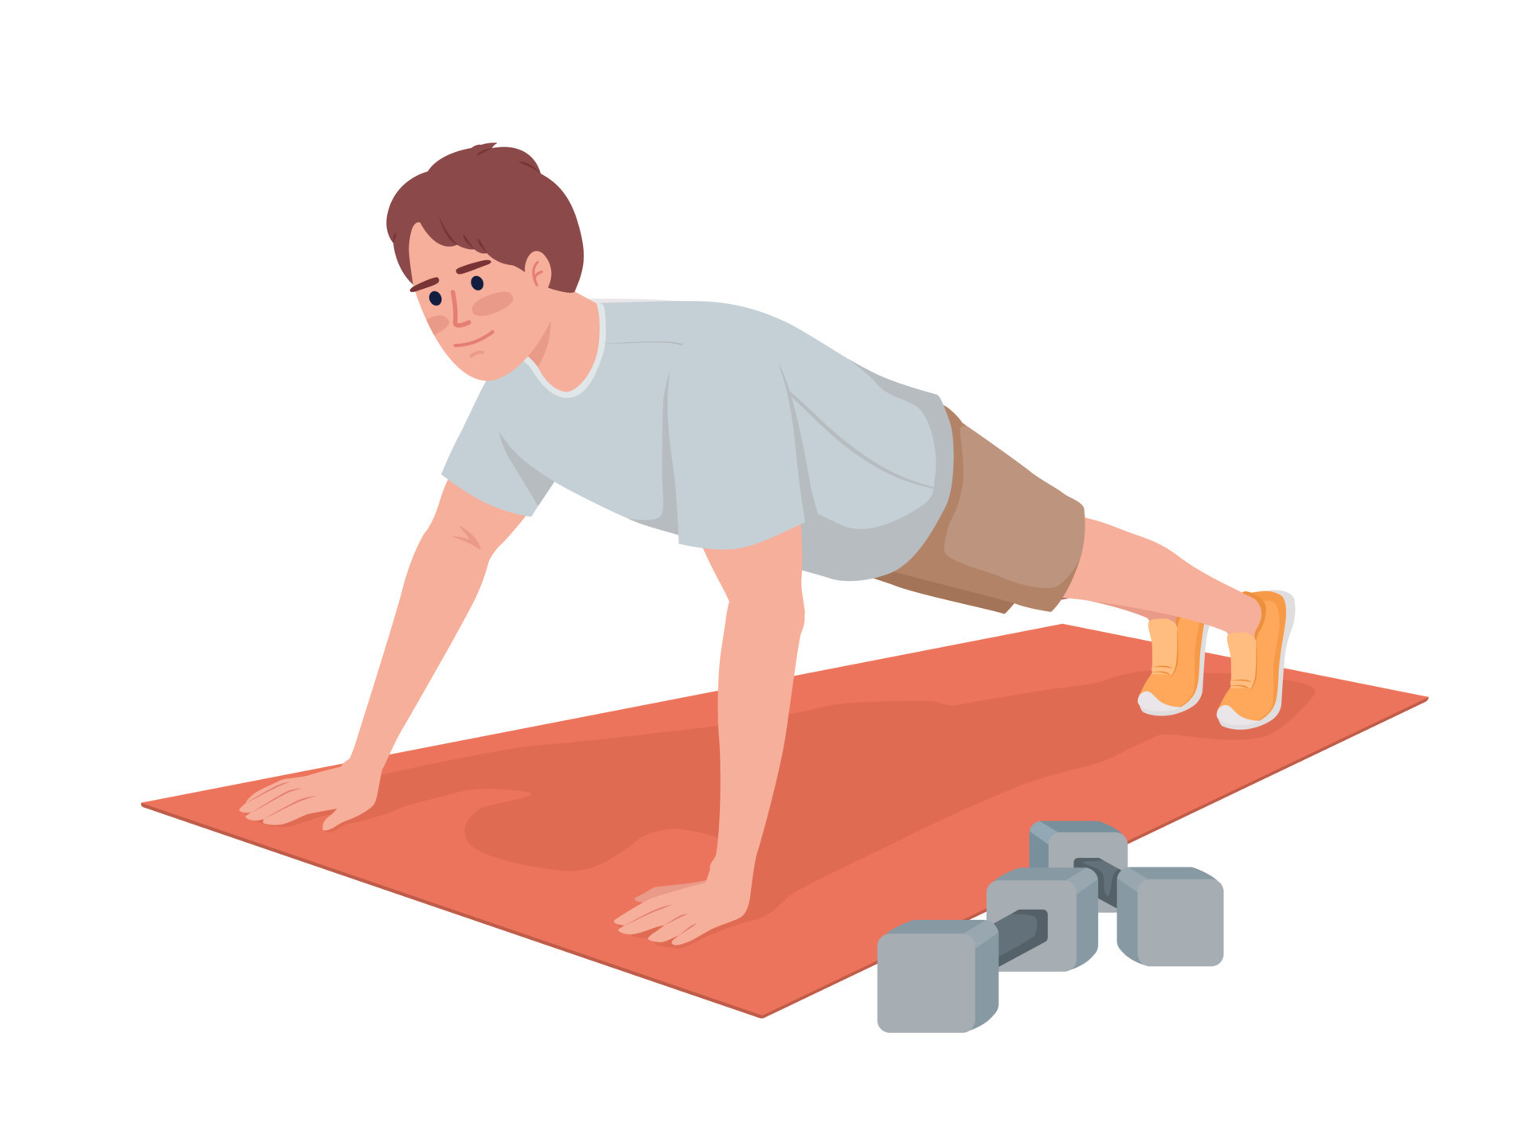

My father goes to the sports centre. He plays tennis.
+ 4
A
B
C
Notes:
There is a lamp. It’s old.
Key: C

Slide 11
Activity 1
02
Listen and repeat

Slide 12

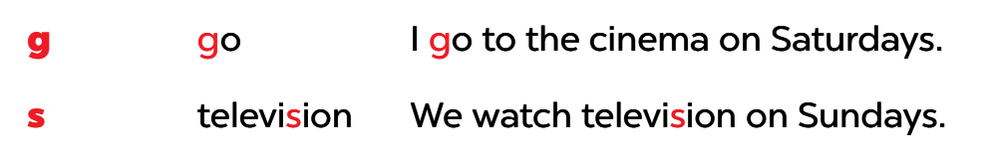
Listen, read and focus on the difference.

Slide 13
Activity 2
03
Listen and cirle

Slide 14
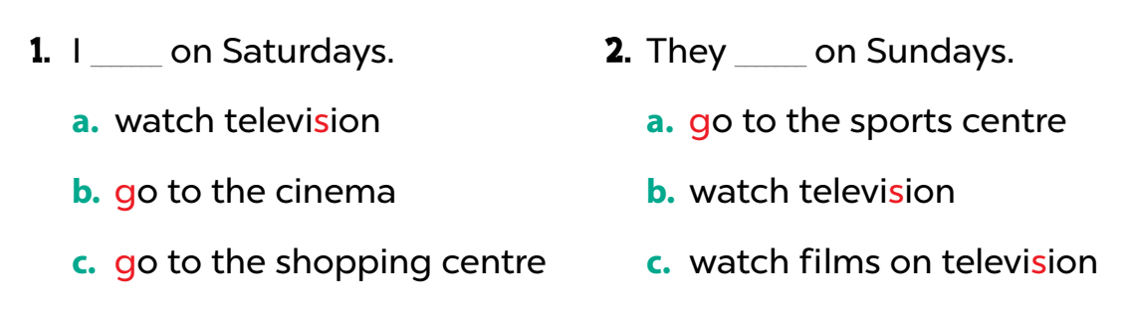
Listen and circle

Slide 15
Activity 3
04
Let's chant

Slide 16
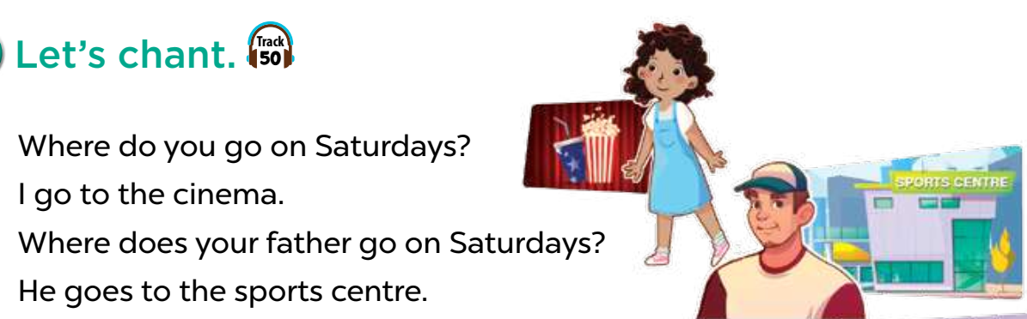
Read the lyrics

Slide 17
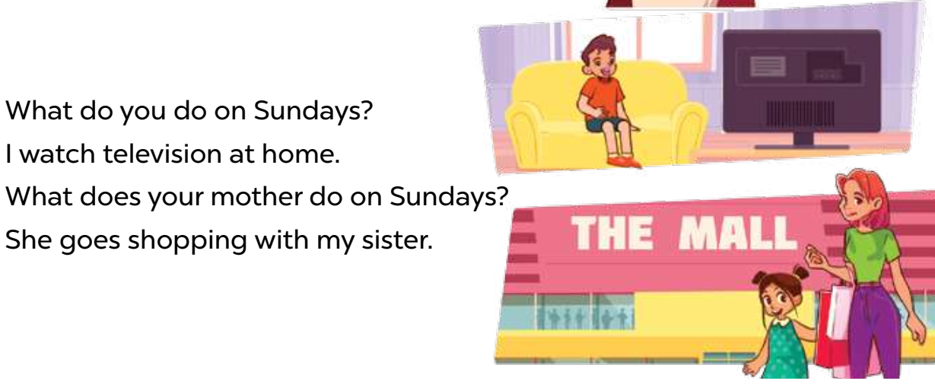
Read the lyrics

Slide 18
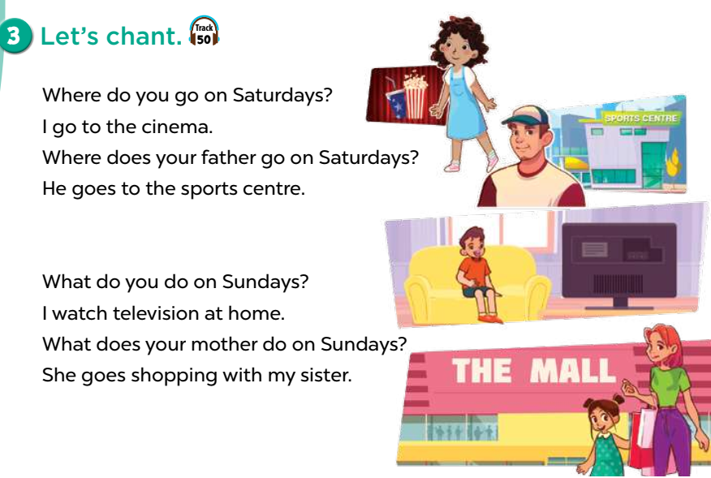
Read the lyrics

Slide 19
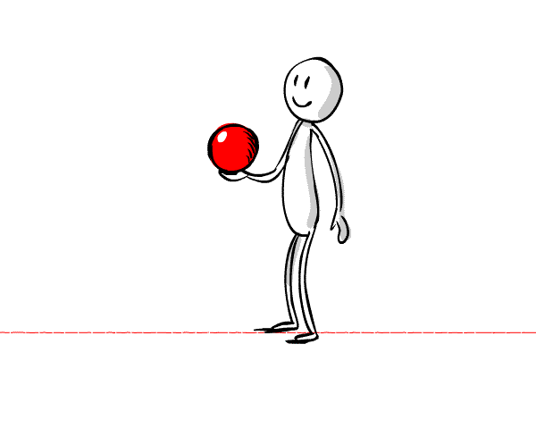
Fun time
02
Listen, then throw the sticky ball

Slide 20

Listen and choose
G
s
10
5
3
1

Slide 21
Listen and choose
G
s
10
5
3
1

Slide 22
Listen and choose
G
s
10
5
3
1

Slide 23
Listen and choose
G
s
10
5
3
1

Slide 24
Listen and choose
G
s
10
5
3
1

Slide 25
Listen and choose
G
s
10
5
3
1

